Slide 1
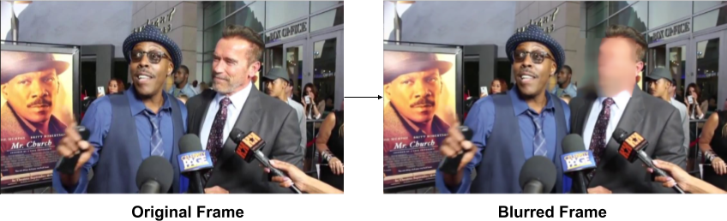
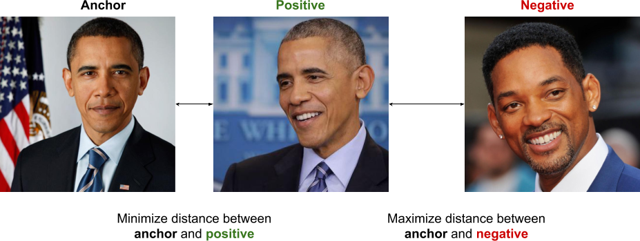
OPTIMIZING DEEP LEARNING KERNELS WITH MACHINE LEARNING Thomas Binu and Shubhanshu Shekhar
Problem Statement
Given a video and a few picture of a person’s face, the project develops an algorithm to efficiently identify blur the person’s face in real time
Method

